Slide 1
PM-16 Protection of Minors
Training for Non-LSU Programs/Third Party Entities
Risk Management

Slide 2

Basic Training for Adults Working in Youth Programs
This training is required for adults working in non-LSU youth programs.
The purpose of this training is to provide guidance for working with Minors as they engage in valuable experiences on campus. It may not encompass every encounter with a minor and should be flexible depending on the circumstances.

Slide 3

Training Instructions
To navigate this training:
Carefully review the information and requirements outlined on each slide.
Move through the slides by using the “Next” and “Previous” buttons on the bottom right of the screen. (You can also use the forward/backward arrow buttons on the bottom left of the menu bar.)
Once you’ve completed the training, print, sign, and return the acknowledgement form to your Program Administrator/Coordinator.

Slide 4
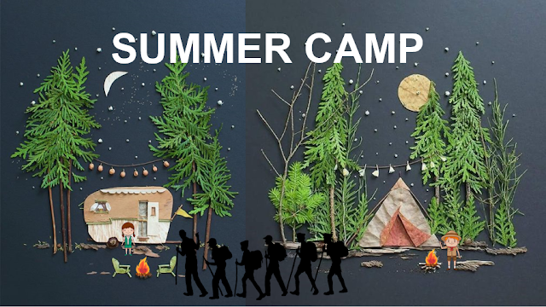
What is a Youth Program?
Any program, activity, or event where one or more Minors are present and supervised by an adult who is not their parent or guardian. Such programs include but are not limited to the following:
Exclusions:
general public events
programs involving students enrolled or accepted for enrollment at LSU
events and activities operated by the University Laboratory Schools or LSU Early Childhood Education Laboratory Preschool
sport camps
day camps
workshops
academic camps
mentoring programs
academic competitions
4-H programs
field trips and conferences
This Photo by Unknown Author is licensed under CC BY-SA-NC

Slide 5
Key Terms
Minor | For the purposes of this policy, a person under the age of eighteen (18) years (except emancipated persons) per the Louisiana Children’s Code (See Source I) and not admitted to LSU as a student as defined by the LSU Code of Student Conduct or legally employed by the University.
Non-LSU supervised program | A program in which Minors will be physically present and participating using any LSU facilities, property, or areas controlled by LSU, but the program is not hosted, supervised, guided or provided program oversight by LSU. Also, any virtual program hosted on the LSU server.
LSU supervised program | Any program or activity where LSU assumes the supervision of Minors, in which Minors will be physically or virtually present and participating under the supervision of LSU employees or adults acting on LSU’s behalf, wherever such program may occur.
Supervision | Supervision of a Minor in the context of this policy means for an adult to assume responsibility for the mental and physical safety and well-being of one or more Minors; and, in most instances, the adult has control or oversight of the actions and activities of the Minor(s).
One-on-One Contact | Personal, secluded, unsupervised interaction with a single Minor without at least one other authorized adult or a parent or legal guardian of the Minor also present.

Slide 6
Key Personnel
Policy Administrator | The Policy Administrator is the LSU employee designated by the University as the central point of contact for all matters regarding this policy and serves as the conduit to keep University leadership informed on issues involving Minors. For information on the current Policy Administrator, please visit the LSU Risk Management website at https://www.lsu.edu/riskmgt/youth/campuses_homepages/youth_lsuam.php
Campus Administrator | An employee of LSU, at least 21 years of age, designated by the leadership of an LSU campus or institution as the responsible party to monitor compliance with this policy, and to notify University leadership and the Policy Administrator of any violations of this policy. A campus must have a designated Campus Administrator if it operates or authorizes programs involving Minor(s).
Authorized Adult | An adult, at least 18 years of age, who is responsible for supervising Minor(s) participating in a Youth Program and has complied with University requirements to be recognized as an Authorized Adult.
Program Administrator | For each Non-LSU Program: An individual (e.g. employee, contractor, etc.), at least 21 years of age, designated by a Non-LSU Program and recognized by an LSU campus as the person coordinating, planning, implementing, supervising a Non-LSU Program and who shall be responsible for ensuring the requirements of this policy are met.
Program Coordinator | The person responsible for the day-to-day coordinating, planning, and implementing of a specific youth program. The Program Coordinator shall be responsible for ensuring policy compliance for the specific program.
Mandated Reporters | Mandated or Mandatory Reporters are those adults identified by State law as required to report known or suspected abuse or neglect of a Minor. All adults working in an LSU supervised youth program or a Non-LSU youth program are Mandated Reporters.
Volunteers | A Volunteer is an adult who assists with an LSU program or non-LSU program without compensation. Volunteers are not employees of the youth program or the University (however, a volunteer may be a University employee who is volunteering outside the scope of their employment). All volunteers must adhere to applicable University policies. If a volunteer will be supervising Minors, then the volunteer must first be approved as an Authorized Adult
LSU Graduate or Undergraduate Students | LSU graduate or undergraduate students need to be approved as an Authorized Adult if they will be supervising Minors. If, on the other hand, they will not be supervising Minors and will be performing duties as assigned by and under the supervision of the program’s Authorized Adult(s), then they do not need to become an Authorized Adult. Students must adhere to applicable University policies.

Slide 7
Non-LSU Programs
All non-LSU programs operating in any LSU facility, property, or other controlled areas for a program or activity and Minors are physically present (including the University Laboratory School and University Early Childhood Education Laboratory Preschool) or hosting a virtual event through the LSU server must comply with Permanent Memorandum- 16.

Slide 8
Non-LSU Program Requirements
Campus-Use Agreement: All non-LSU programs covered by PM-16 must request and execute the LSU Campus-Use Agreement.
Insurance and Certificate of Insurance: All non-LSU programs must maintain the minimum insurance limits for youth programs and submit a certificate of insurance as evidence of coverage. Additional information can be found in the Risk Management website.
Program Registration and Approval: All non-LSU youth programs must be registered and approved by the LSU Office of Risk Management. Registration shall be completed annually, at least 30 days prior to the start of the program.
Training and Background Checks: All non-LSU Programs must ensure that the adults participating in their programs have fulfilled the background and training requirements prior to working in the non-LSU Program.

Slide 9
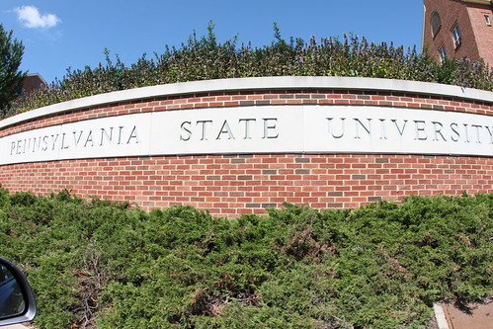
Explore: The Penn State Scandal
The Penn State Scandal is one of the most notorious university child abuse scandal in American history. It is a prime example of what can happen when people neglect their responsibility to report child abuse.
Beginning
The Penn State Scandal started with Jerry Sandusky, an assistant coach for the Penn State Nittany Lions football team, engaging in sexual abuse of children over a period of at least 15 years. The abuse may have begun as early as the 1970s.
Criminal Charges
On June 22, 2012, Sandusky was convicted of 45 counts of sexual
abuse. He was sentenced to a minimum of 30 years and a maximum
of 60 years in prison.
This Photo by Unknown Author is licensed under CC BY

Slide 10

Outcome of The Penn State Scandal
Impact
The school president, vice president, & athletic director were charged with perjury, obstruction of justice, failure to report suspected child abuse, and related charges, though some were later dropped.
Shortly after the scandal broke, the university president resigned and the Penn State Board of Trustees terminated the contracts of the athletic director and of the longtime head football coach.
Report
The Board of Trustees commissioned an independent investigation of
the scandal. The Freeh Report stated that the President, Head Coach,
Athletic Director, and Vice President had known about the child abuse
allegations as early as 1998 and were complicit in failing to disclose them.
The investigation found a "total and consistent disregard by the most senior leaders at Penn State for the safety and welfare of Sandusky's child victims," which "empowered" Sandusky to continue his abuse.

Slide 11
Supervision
Proper adult supervision is crucial for protecting Minors. Supervision of a Minor in a youth program means that an adult will assume responsibility for the mental and physical safety and well-being of one or more Minor; and, in most instances, the supervising adult has control or oversight of the actions and activities of the Minor(s).

Slide 12
Supervision
General: Only authorized adults can supervise Minors. Authorized adults must have background checks and complete training.
One-on One Contact
Adults shall NOT have one-on-one contact with Minors except in emergency circumstances.
One (1) Authorized Adult and at least one (1) other adult shall remain in each other’s presence while supervising a single minor.
Adult to Minor Supervision Ratios
Non-LSU programs shall ensure there is an adequate number of adults to supervise Minor participants.
Adult to Minor Supervision Ratios
Minor Participants | Adult to Minor Ratio
10 years old and older | 1 Authorized Adult for every 30 Minors(plus one or more additional adults).
Under 10 years old | 1 Authorized Adult for every 20 Minors (plus one or more additional adults).

Slide 13
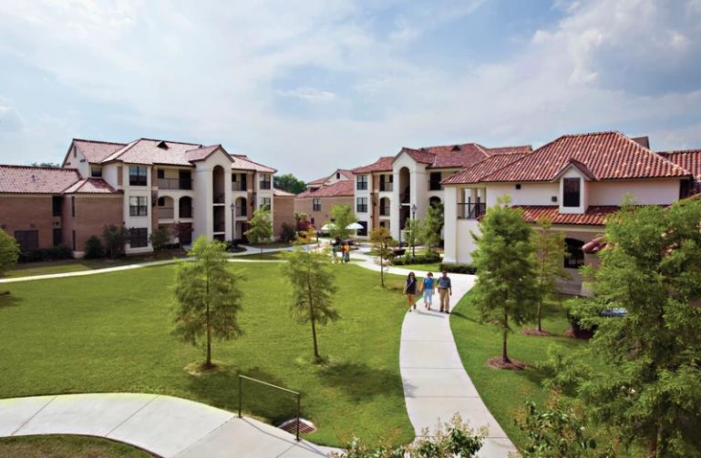
Overnight Supervision
Some situations may require Minors to stay overnight on campus. Adults shall NOT participate in any overnight activity as part of a youth program, unless (1) the Minor's parents or guardians are present or (2) the Minor's parents or guardians has given express written consent, and two or more authorized adults are present.
At least two authorized adults must be designated by the Youth Program coordinator/administrator when Minors are staying overnight regardless of the number of participants. Youth Program Administrator shall provide all contact numbers to LSU Residential Life.

Slide 14

Appropriate Touch
As a rule, do not touch Minors in a manner that a reasonable person could interpret as inappropriate.
Appropriate touching that is generally acceptable includes:
  shaking hands,
  high fives & hand slapping,
  and hand signs & greetings.
Not every minor will be comfortable with physical touch. Some Minors who have previously suffered abuse may not verbalize their discomfort.
The minor must consent to any touching, and it must be appropriate to the situation.

Slide 15

Inappropriate Touch
Do NOT strike, hit, touch or administer corporal punishment to any Minor.
Do NOT have one-on-one contact with Minors.
Remain in the presence of at least one other authorized adult while supervising a single Minor.

Slide 16
Appropriate Behavior
Be friendly with Minors but maintain discipline and discourage inappropriate behavior. Conduct any necessary one-on-one interactions with Minors in a public environment where you can be observed.
Listen to Minors and provide positive reinforcement. Be consistent and treat every Minor in a group fairly and with respect and dignity. Be cognizant of how your words, actions, or intentions might be perceived and could be misinterpreted.
Consult with other adult supervisors if you feel uncertain about a situation.

Slide 17
Inappropriate Behavior
Do NOT engage in or allow prohibited, abusive or illegal conduct or language of any kind toward or in the presence of a Minor.
DO NOT make sexually suggestive or explicit remarks or gestures.
DO NOT make sexually explicit materials available to Minors or assist them in gaining access to such materials.
Do NOT communicate via email, text message, social media, etc., with Minors at any time except for official purposes.
(This requirement is not meant to prohibit communications between adults and Minors sharing a relationship such as by blood, marriage, adoption or foster care.)
Materials should NOT be present during the time the adult will be working in a program or otherwise in the presence of Minors.
Communication must be consistent with program’s mission and included in a group message with the Program Administrator or another Authorized Adult copied.

Slide 18
Appropriate vs Inappropriate
Appropriate | Inappropriate
Giving a student a high-five after they set a personal best time running 50m | Touching a student on the shoulder while they pull away
Shaking a student’s hand while teaching them to handle a job interview | Laughing when one student dumps soda over another
Encouraging a student enrolling at LSU to consider a challenging degree program | Providing candy containing cannabis to a minor experiencing anxiety
Instructing students to be quiet while a Model United Nations delegate speaks | Slapping a student’s buttocks after scoring a run in softball
Giving a student a fist bump at the end of the day | Providing one-on-one tutoring with a student outside official hours

Slide 19

Transportation
Programs must develop their own transportation plans, including information regarding the transportation of Minors at the beginning.
Do NOT pick up or drop off Minors at their homes or locations, unless
  the parent or legal guardian is in the vehicle or
  the parent or legal guardian has provided written consent AND at least two (2) adults are present including one authorized adult.
This requirement is not meant to prohibit this activity by adults sharing a relationship established by blood, marriage, adoption, or foster care or person with whom the child resides.

Slide 20
Mandatory Reporting
All adults working in a Non-LSU youth program with a few exceptions are Mandated Reporters and required to report instances of Sexual Misconduct. Please see guidelines for exceptions.
Any person who knows or reasonably suspects that a Minor is the victim of abuse or neglect is required by law to report it immediately. The person who witnesses or suspects Minor abuse or neglect must be the one who reports.
You do not need to know with certainty that abuse is taking place. You need only a reasonable belief or suspicion that child abuse has occurred. When in doubt, report it.
If you suspect a child is a victim of abuse or neglect, crimes, and/or violations of LSU’s Title IX Policy or Protection of Minors Policy, contact the following:
  Dept of Children and Family Services (DCFS) hotline: 1-855-4LA-KIDS (1-855-452-5437)
  LSU Police Department| 225-578-3231
  The Division of Engagement, Civil Rights & Title IX|225-578-5736
  The Office of Risk Management| youthprotect@lsu.edu |225-578-3283

Slide 21

Background Checks
General: non-LSU programs shall ensure that background checks are completed in accordance with all applicable Federal, State local laws, and LSUFASOP: HR-04.
All adults working in youth programs must undergo a criminal background check and fingerprinting. It is the Program Administrator’s responsibility to ensure that all employees complete the required background checks before they begin working the youth program. For more information, please contact the Louisiana State Police.

Slide 22
What is the Clery Act?
The Clery Act is a federal law also known as the Campus Security Act that requires LSU to keep and disclose information about crime on campus. Any crimes witnessed by you or reported to you must be reported to LSU PD. LSU Police Department compiles and reports this information on behalf of the University.
All adults working in non-LSU programs are considered Campus Security Authorities under the Clery Act. It is the youth program’s responsibility to ensure its employees are familiar with their reporting responsibilities.

Slide 23


Questions?
For questions or concerns: please contact LSU’s Office of Risk Management at:
Youthprotect@lsu.edu
Pearl Legarth, plegarth@lsu.edu |225.578.7906

Slide 24


Acknowledgment Form
*Please sign and return this form to the Program Administrator/Coordinator or your immediate supervisor.
I have read and acknowledge the above Basic Training for Adults in youth programs and agree to abide by all Requirements. I understand that it is my responsibility to abide by the University’s Youth Protection Policies.
Signature: ________________________________ Date: ____________
Printed Name: _______________________________

Slide 25

Acknowledgement form-Program Administrator/Coordinator
I have read and completed Basic Training for adults in and agree to abide by all Requirements. I understand that it is my responsibility to abide by the University’s Youth Protection Policies and to gather the requested and required information and submit all information to the LSU’s Office of Risk Management in a timely manner prior to the event start date. Failure to do so may result in this event being cancelled or rescheduled.
Program Administrator/Coordinator Signature: ________________________________ Date: ____________
Program Administrator/Coordinator Printed Name: _______________________________Date: ____________

